Slide 1
Security in Operating System
System Security: Program threats, system and network threats, Cryptography as a Security Tool, User Authentication, Firewalling, Computer security classification, Guarded Models for intrusion detection (Paper Based Study)

Slide 2
System Protection (Preview)
Protecting files and other resources accidental misuse by cooperating
from users
sharing a system.
This is for normal purposes

Slide 3
System Security
Deals with protecting systems from deliberate attacks, either internal or external individuals.
Individuals intentionally attempts to steal information, damage information.

Slide 4
Types of Violations
Basically there are following breach of security:
Breach of Confidentiality
Breach of Integrity
Breach of Availability
This is a commonly known as CIA triad in information security Theory

Slide 5
Breach of Confidentiality
Theft of private or confidential information,
For example: credit-card numbers, trade secrets, patents, secret formulas, manufacturing procedures, medical information, financial information, etc.

Slide 6
Breach of Integrity
Unauthorized modification of data, which may have serious indirect consequences.
For example a popular game or other program's source code could be modified to open up security holes on users systems before being released to the public.

Slide 7
Breach of Availability
Unauthorized destruction of data, often just for the "fun" of causing havoc and for bragging rites. Vandalism of web sites is a common form of this violation.

Slide 8
Types of attack
In general, there are following possible attack in computer system.
Active attack Vs Passive Attack
Inside Attack Vs Outside Attack
Passive Attack
Eavesdropping
Wiretapping/port scan etc
Active Attack
Denial of Service
Man in the middle attack

Slide 9

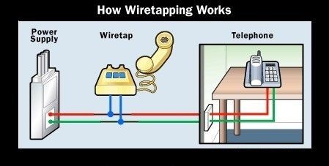
Some Pictures
Eavesdropping and wiretapping

Slide 10
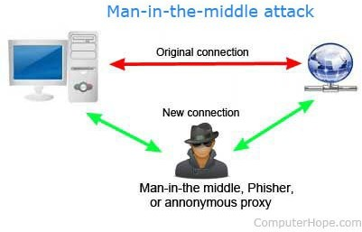
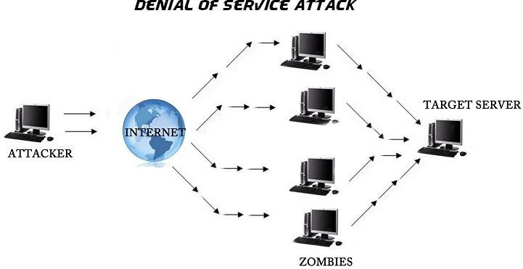
Some pictures
Picture Source: Google Image

Slide 11
Level of Protections
There are four levels at which a system must be protected:
Physical
Human
social engineering,
Phishing
Dumpster Diving
Password Cracking
Operating System
Network

Slide 12
Threat
Program Threat
System threat

Slide 13
Program Threat
A Trojan Horse is a program that secretly performs some maliciousness in addition to its visible actions.
A classic Trojan Horse is a login emulator,
which records a users account name and password, issues a "password incorrect" message, and then logs off the system
The user then tries again ( with a proper login prompt ), logs in successfully, and doesn't realize that their information has been stolen

Slide 14
Threat: Trap Door
A Trap Door is when a designer or a programmer ( or hacker ) deliberately inserts a security hole that they can use later to access the system
A clever trap door could be inserted into a compiler, so that any programs compiled with that compiler would contain a security hole

Slide 15
Other threats
Logic Bomb
Stack and Buffer Overflow
Viruses: designed to replicate itself

Slide 16
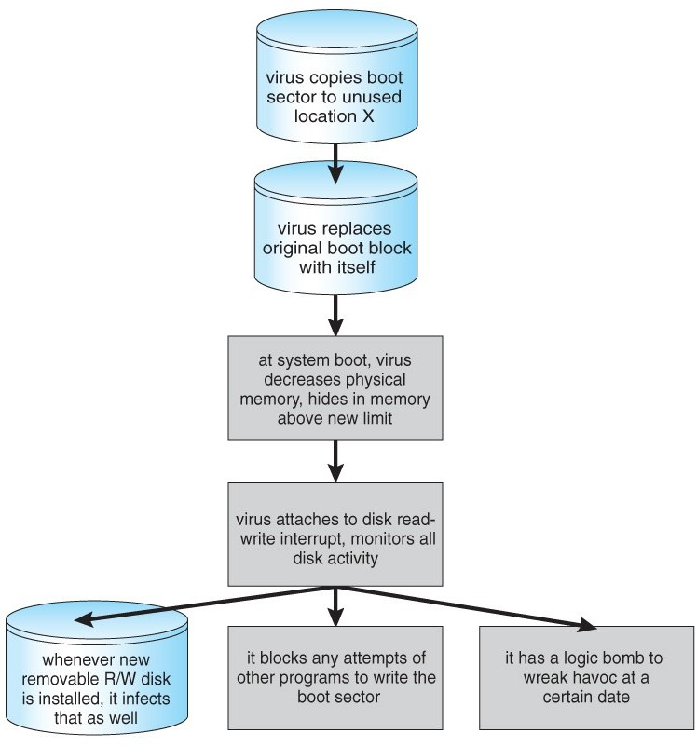

Slide 17
System and Network Threats
A worm is a process that uses the fork / spawn process to make copies of itself in order to wreak havoc on a system.
Worms consume system resources, often blocking out other, legitimate processes.
Worms that propagate over networks can be especially problematic, as they can tie up vast amounts of network resources and bring down large-scale systems.

Slide 18
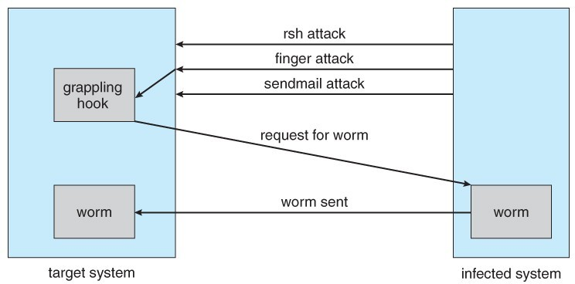
The Morris Internet worm

Slide 19
Port Scanning
Port Scanning is technically not an attack, but rather a search for vulnerabilities to attack.
Try to connect to every node and attempt to contact.
Once the port is determined, next step is to determine what daemon is listening, and is there any flaw in the version of daemon.
nmap ( http://www.insecure.org/nmap ) and
nessus ( http://www.nessus.org )

Slide 20
Denial of Service
Denial of Service ( DOS ) attacks do not attempt to actually access or damage systems, but merely to clog them up so badly that they cannot be used for any useful work. Tight loops that repeatedly request system services are an obvious form of this attack.
DDOS: distributed DOS

Slide 21
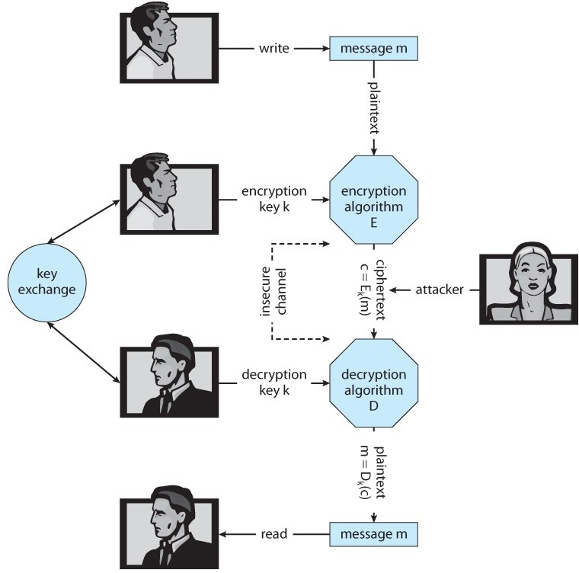
Cryptography as Security tools
Fig: Encryption and Decryption

Slide 22
Implementation of Cryptography
Network communications are implemented in multiple layers - Physical, Data Link, Network, Transport, and Application being the most common breakdown.
At the network layer the most common standard is IPSec, a secure form of the IP layer, which is used to set up Virtual Private Networks, VPNs. At the transport layer the most common implementation is SSL.

Slide 23
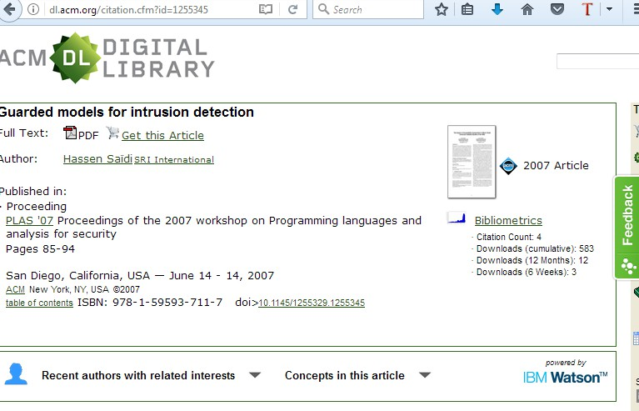
Research Paper Review

Slide 24
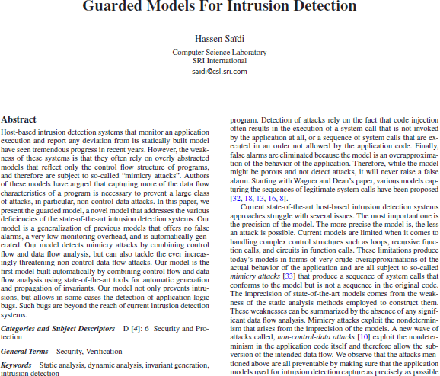

Slide 25
Thank You

